Slide 1
Phishing Emails and Websites
Bayesian Analysis Midterm Presentation

Slide 2
Introduction
Phishing: “A technique for attempting to acquire sensitive data, such as bank account numbers, through a fraudulent solicitation in email or on a web site, in which the perpetrator masquerades as a legitimate business or reputable person” (NIST).
Phishing is the most common type of social engineering and costs individuals and companies huge financial losses (IBM).

Slide 3
Question
HOW MANY PHISHING EMAILS ARE SENT DAILY IN 2024? 11+ STATISTICS
“Almost half of all the emails sent in 2021 are phishing emails”
47.3%
Source?
Based on other given data, they probably meant almost half were spam (not phishing)
Going to entertain this number as a prior

Slide 4
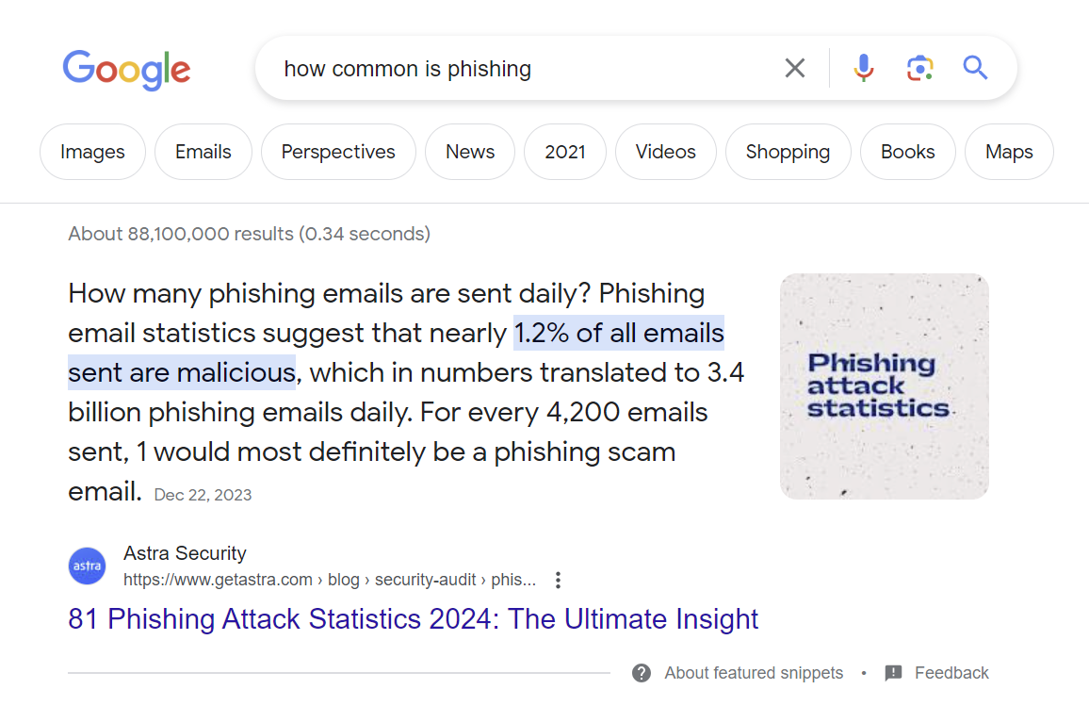

Slide 5
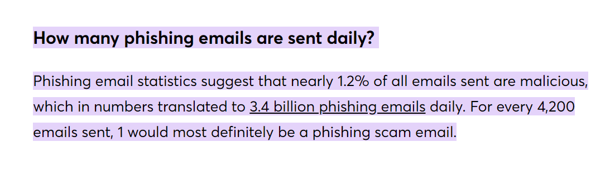
https://www.getastra.com/blog/security-audit/phishing-attack-statistics

Slide 6
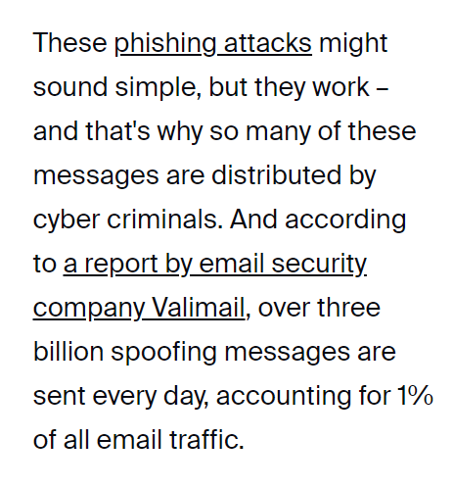
https://www.zdnet.com/article/three-billion-phishing-emails-are-sent-every-day-but-one-change-could-make-life-much-harder-for-scammers/

Slide 7
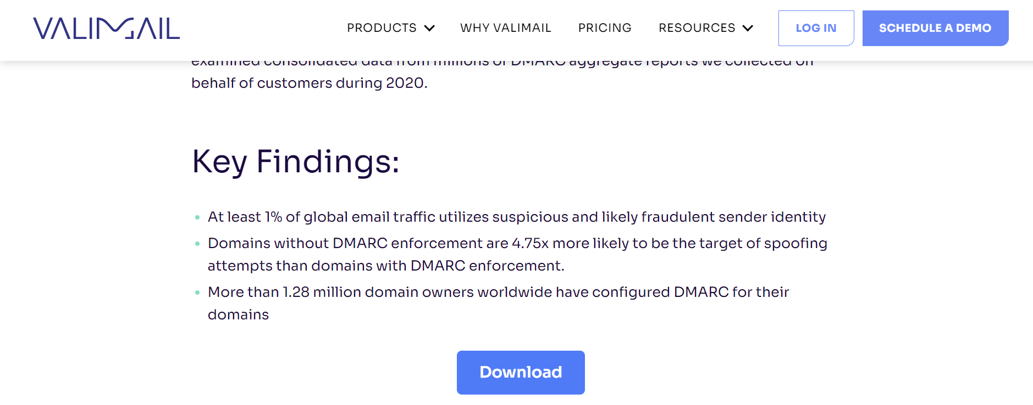
https://www.valimail.com/blog/email-fraud-spring-2021/

Slide 8
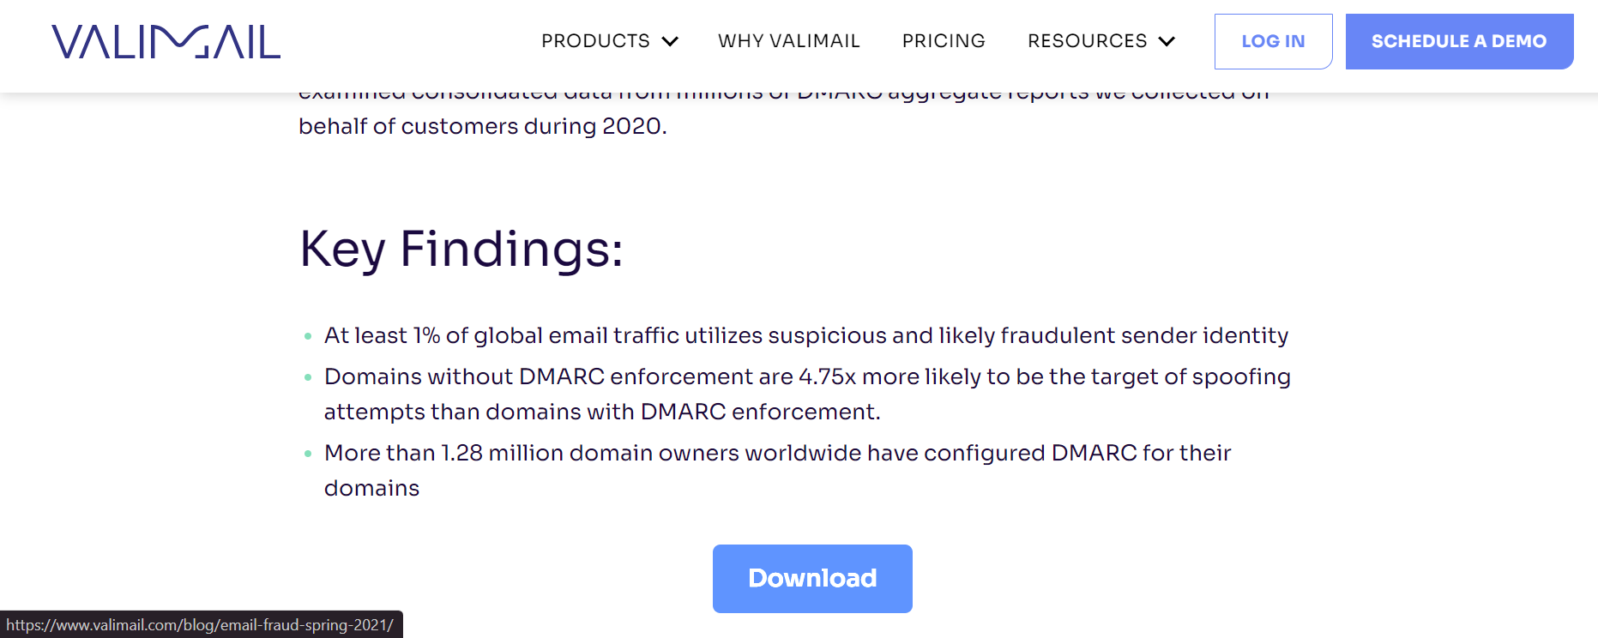
https://www.valimail.com/blog/email-fraud-spring-2021/

Slide 9
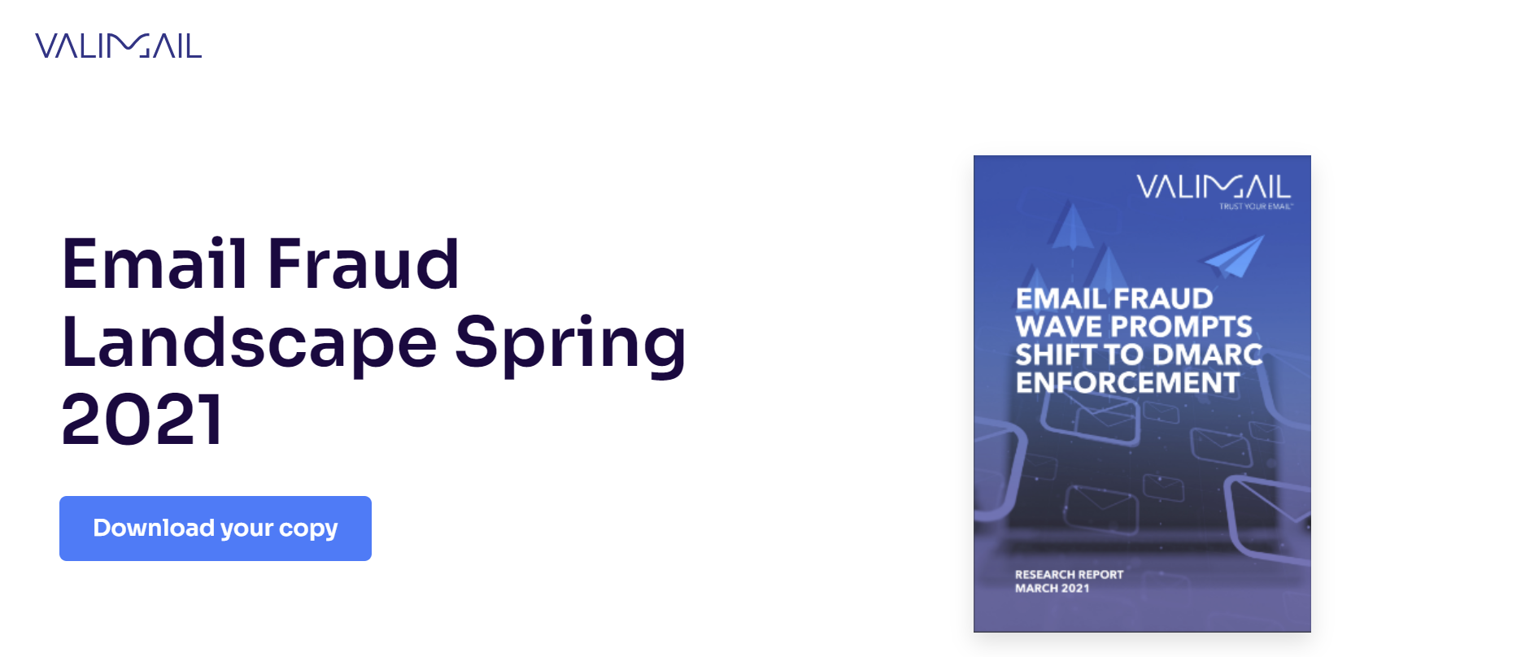
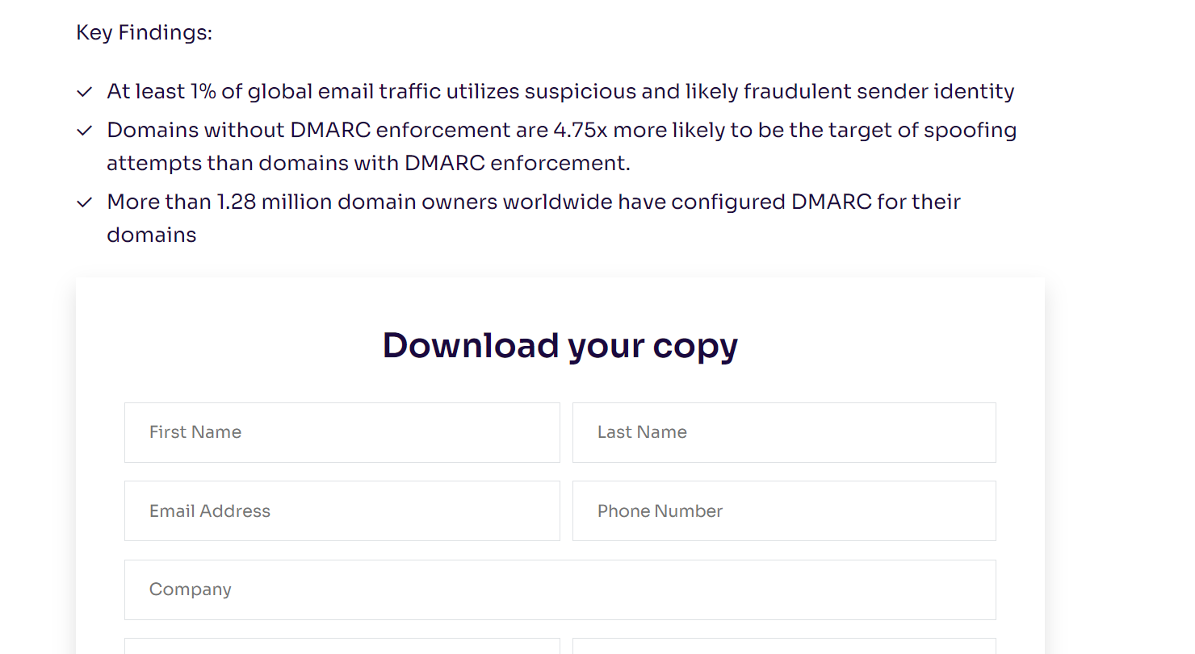
https://www.valimail.com/ressource-page/email-fraud-landscape-spring-2021/#form

Slide 10
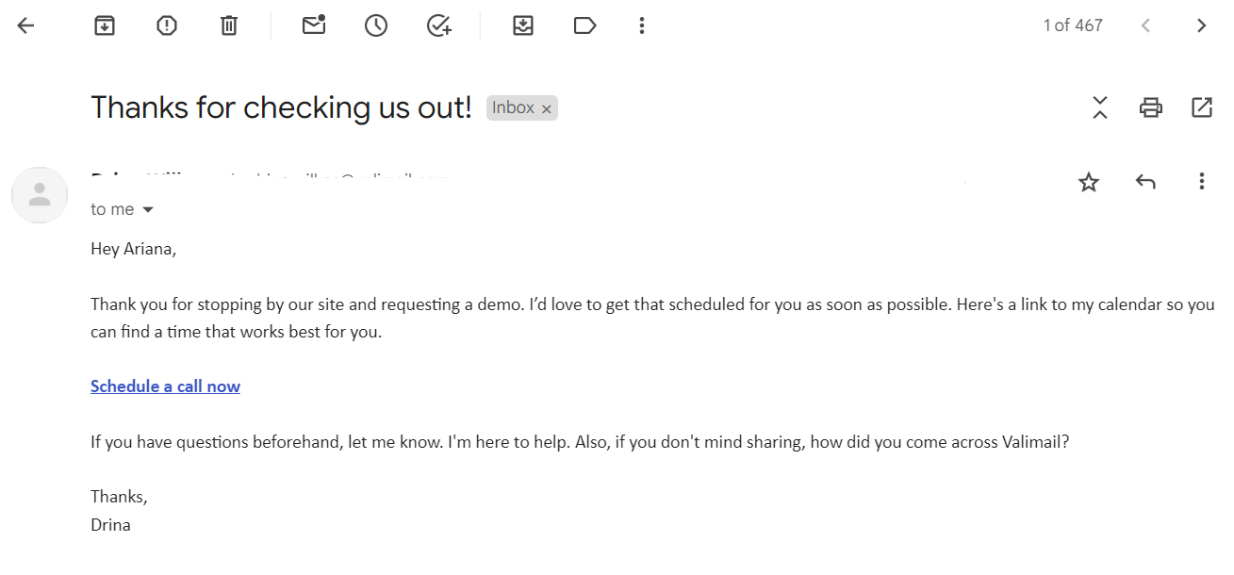

Slide 11
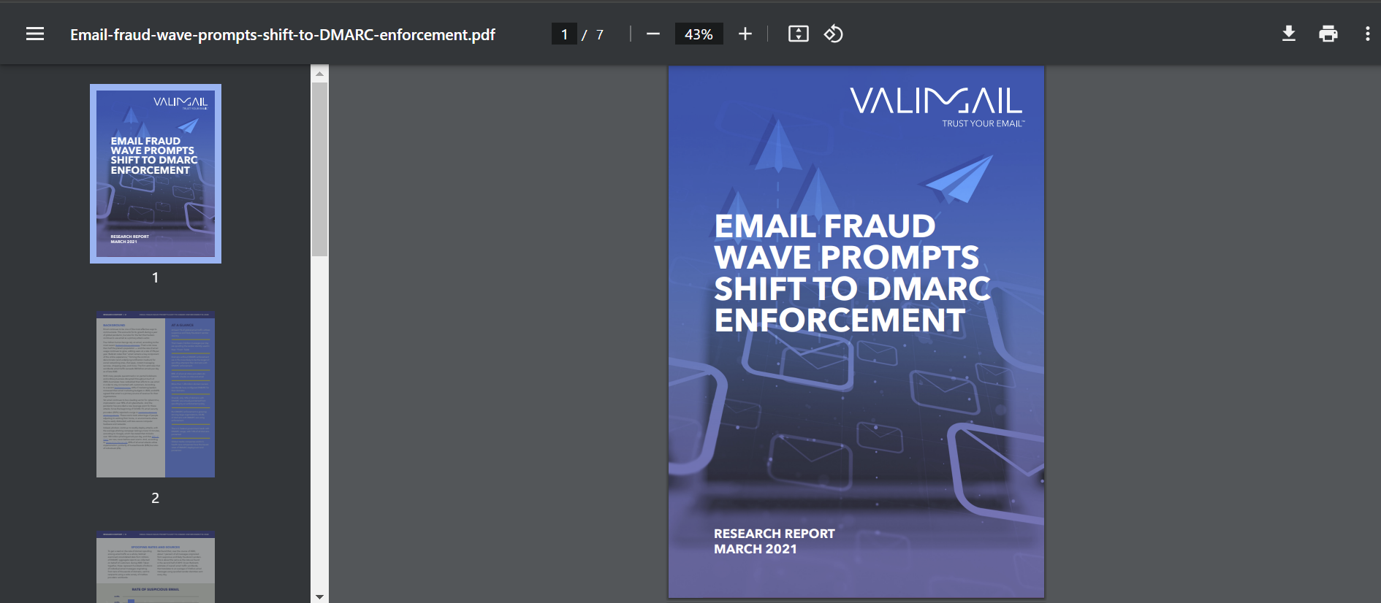
https://www.valimail.com/wp-content/uploads/2021/05/Email-fraud-wave-prompts-shift-to-DMARC-enforcement.pdf

Slide 12
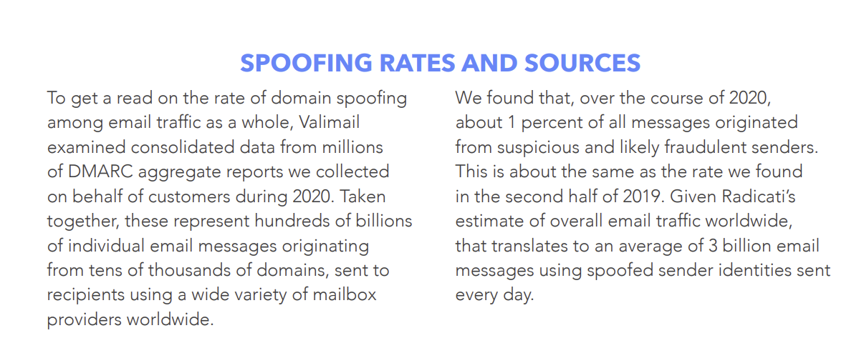
https://www.valimail.com/wp-content/uploads/2021/05/Email-fraud-wave-prompts-shift-to-DMARC-enforcement.pdf

Slide 13
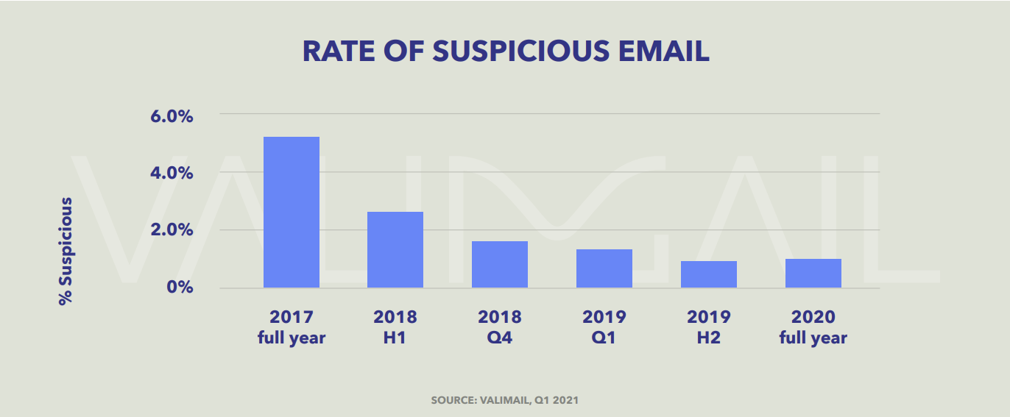
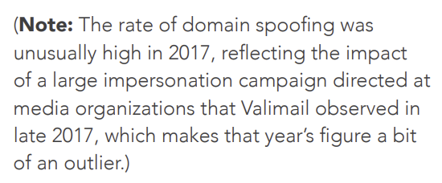
https://www.valimail.com/wp-content/uploads/2021/05/Email-fraud-wave-prompts-shift-to-DMARC-enforcement.pdf

Slide 14
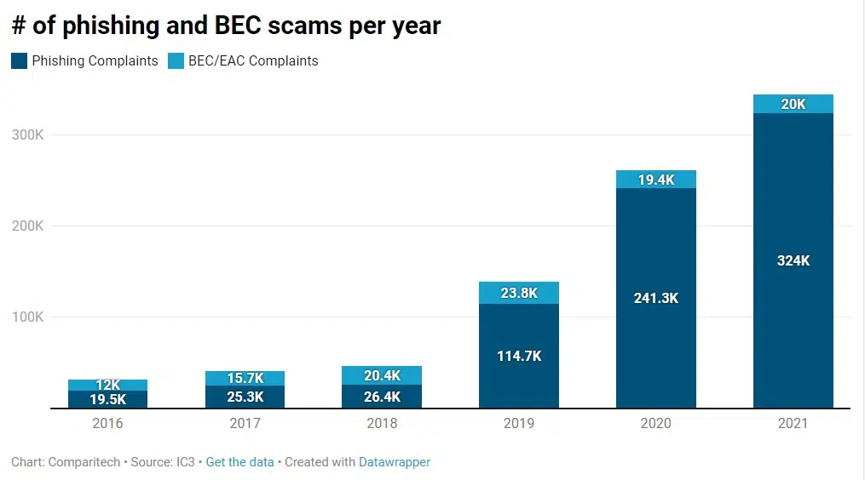
https://www.comparitech.com/blog/information-security/state-of-phishing/
https://www.ic3.gov/Media/PDF/AnnualReport/2021_IC3Report.pdf
Notes:
Ic3 internet crime complaint center

Slide 15
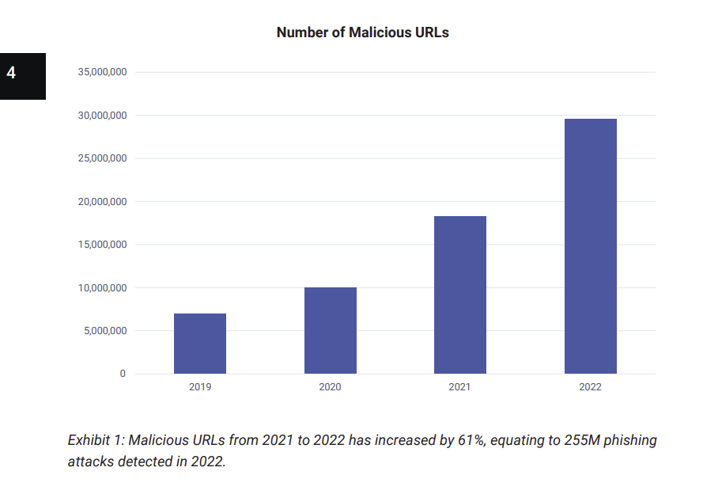
https://www.slashnext.com/wp-content/uploads/2022/10/SlashNext-The-State-of-Phishing-2022.pdf

Slide 16
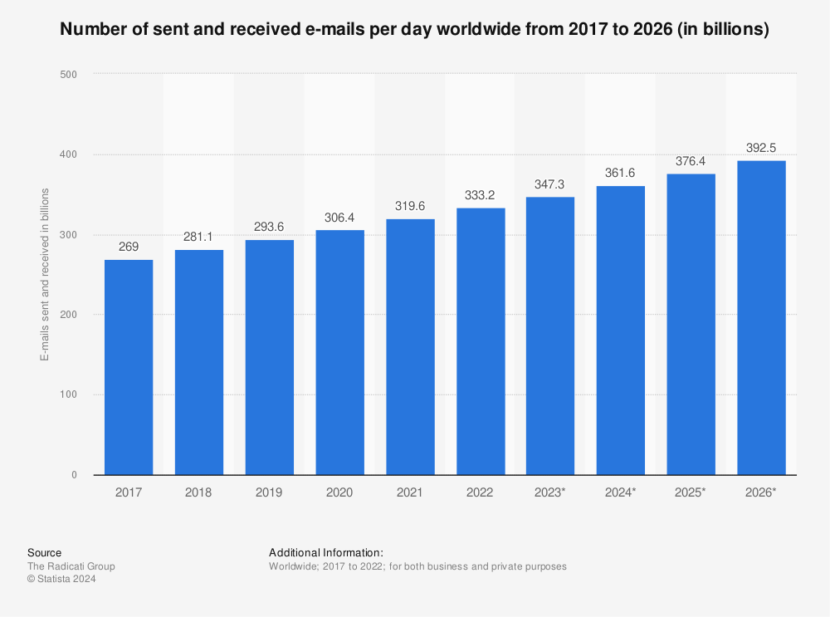
https://www.statista.com/statistics/456500/daily-number-of-e-mails-worldwide/

Slide 17
Phishing Link Data

Slide 18
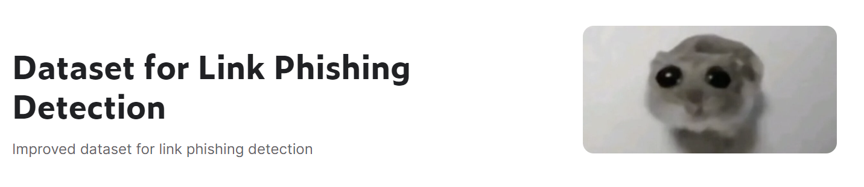
Data Source
Kaggle
Dataset for Link Phishing Detection (Kaggle)
Web Page Phishing Detection (Kaggle)
Phishing Detection with same Bait (Kaggle)
Web page phishing detection (Mendeley Data)
“This dataset is specifically designed for phishing link detection. It contains a variety of features that can be used to predict whether a URL is phishing or not. The dataset includes features extracted from the URL, the HTML content, and the domain.”

Slide 19
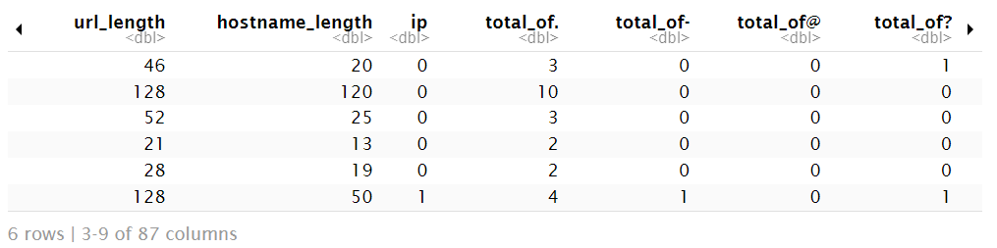
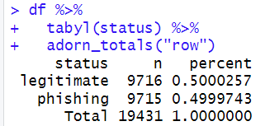

Slide 20
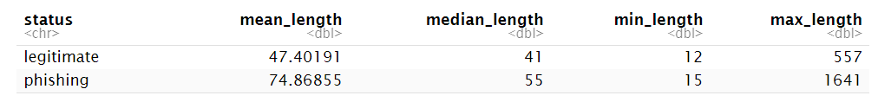
URL Length

Slide 21
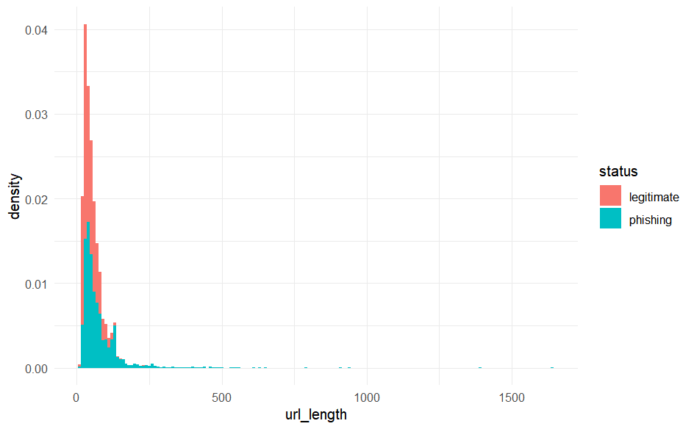

Slide 22
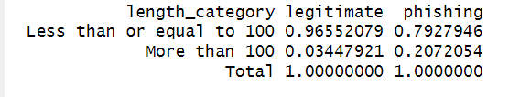
URL Length >100
335/9716 (3.45%) legitimate have a url length of >100
2013/9715 (20.72%) phishing emails have a url length of >100

Slide 23
Bayesian event model
 | B | B^{C} | total
Prior probability | 0.473 | 0.527 | 1
Posterior probability | 0.8434 | 0.1566 | 1
What is the probability that a URL is a phishing attempt given that its length is greater than 100?

Slide 24
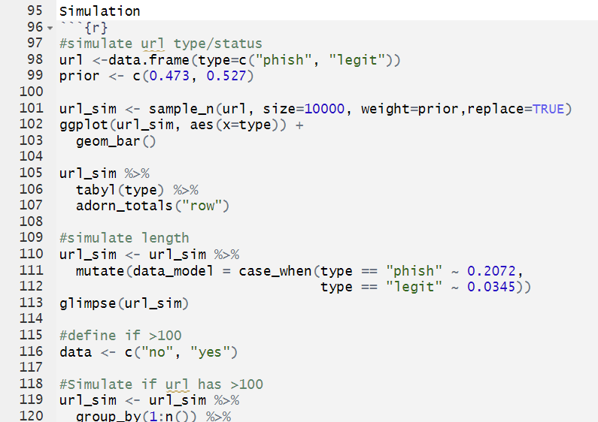
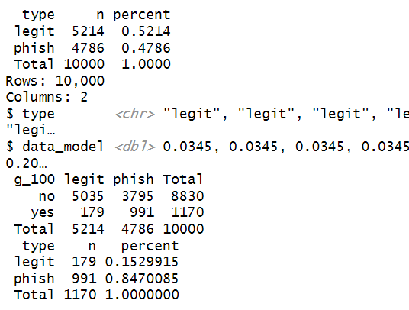
Simulation
What is the probability that a URL is a phishing attempt given that its length is greater than 100?

Slide 25
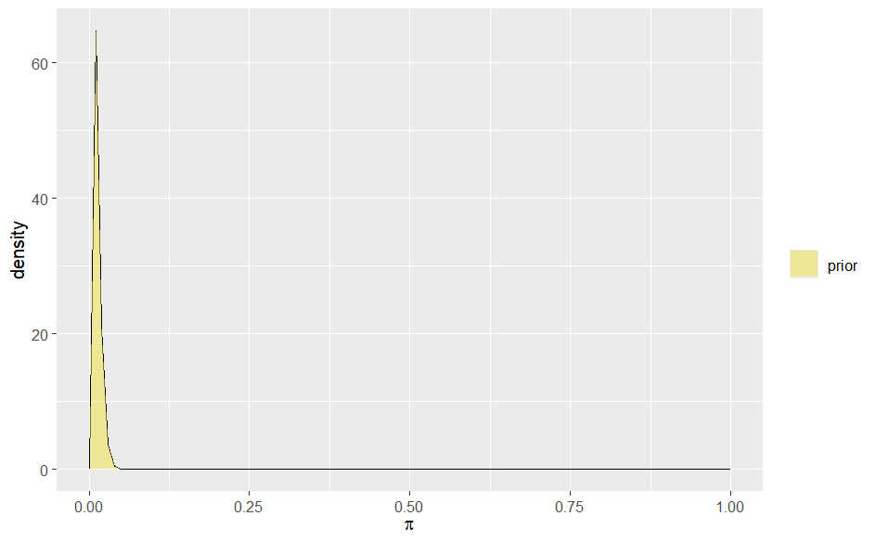
Beta-Binomial Model
Now let’s say that we believe about 1.2% of all emails are phishing attempts
Beta(3,250) strong prior

